Slide 1
Trees

Slide 2


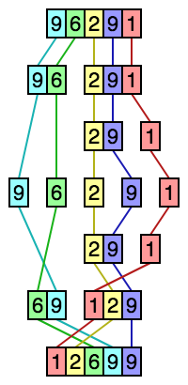

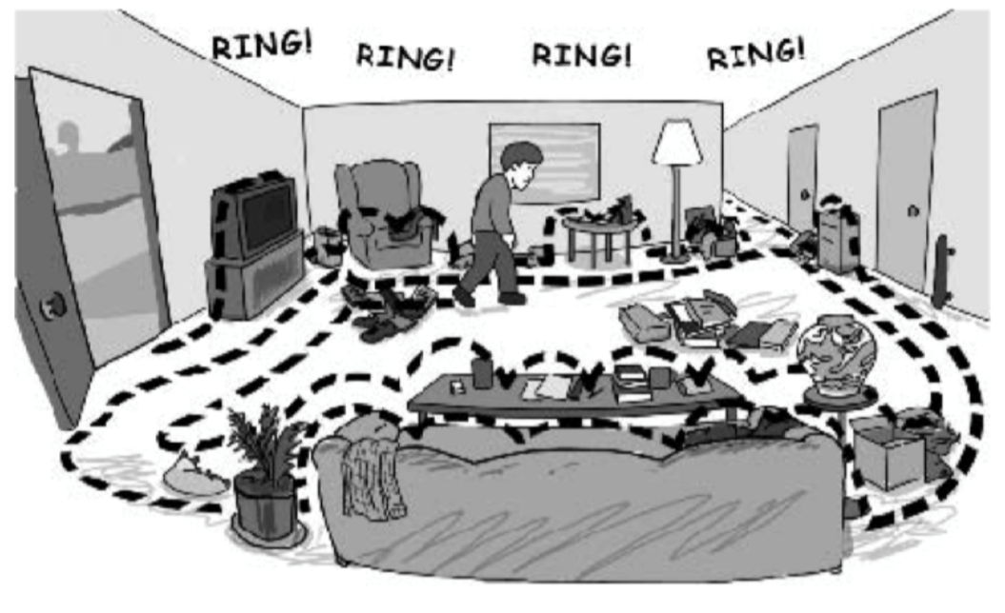
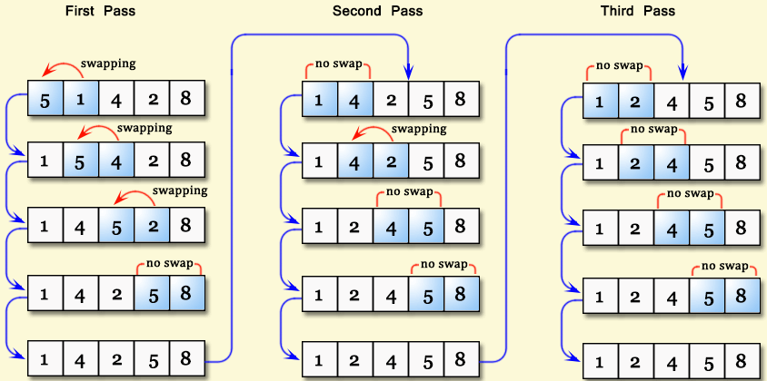
Identify the following data structures & algorithms

Slide 3
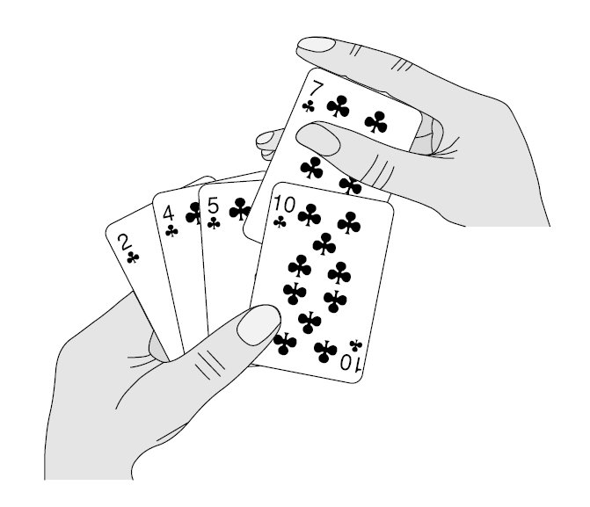
Data Structures & Algorithms
Data Structures:
    Stacks
    Queue
      Linear Queue
      Circular Queue
    List
      Singly Linked List
Algorithms
    Searching
      Binary Search
      Linear Search
    Sorting
      Bubble Sort
      Selection Sort
      Insertion Sort
      Merge Sort

Slide 4
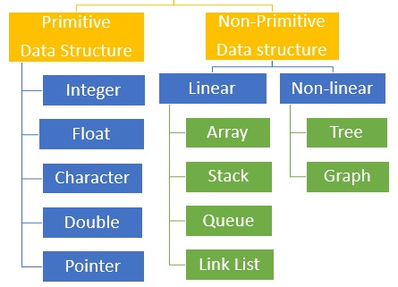
Data Structures

Slide 5



Tree Data Structure
Extension of Linked List structure:
• Each node connects to multiple nodes
• Example usages include
File systems, Java class hierarchies

Slide 6
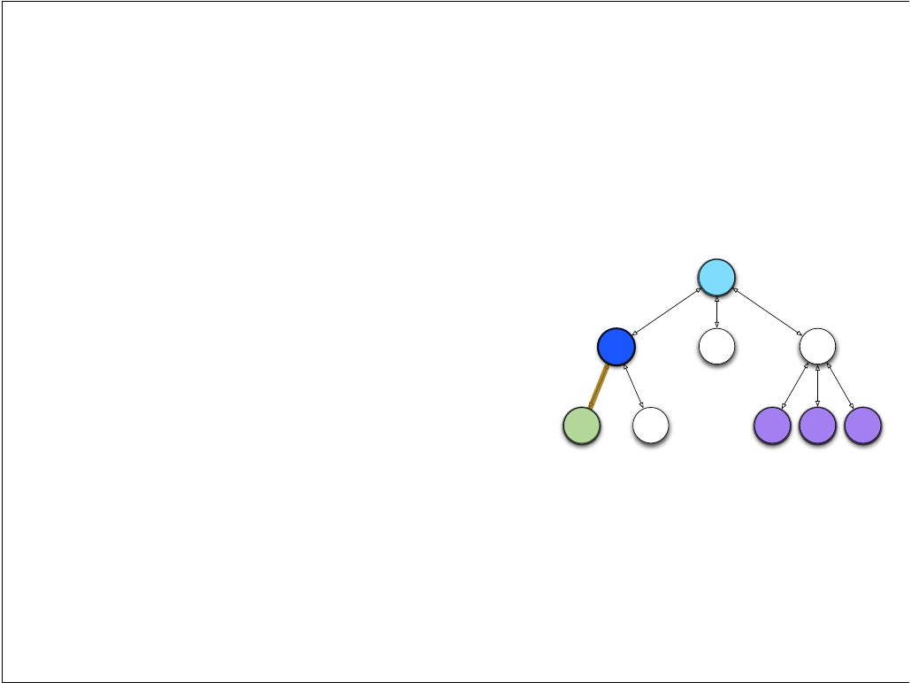
Tree Terminology
Just like Linked Lists, Trees are collections of nodes
Conceptualize trees upside down (like family trees)
the top node is the root
nodes are connected by edges
edges deﬁne parent and child nodes
nodes with no children are called leaves

Slide 7
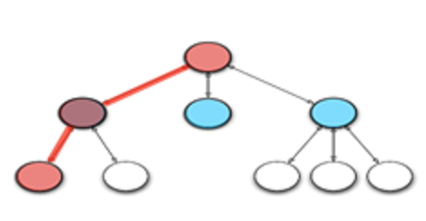
Tree Terminology
Nodes that share the same parent are siblings
A path is a sequence of nodes such that the next node in the sequence is a child of the previous

Slide 8
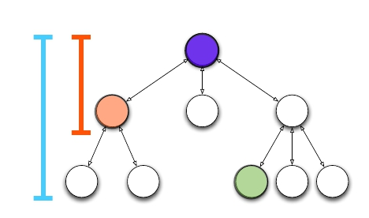
Tree Terminology
a node's depth is the length of the path from root
the height of a tree is the maximum depth
if a path exists between two nodes, one is an ancestor and the other is a descendant

Slide 9
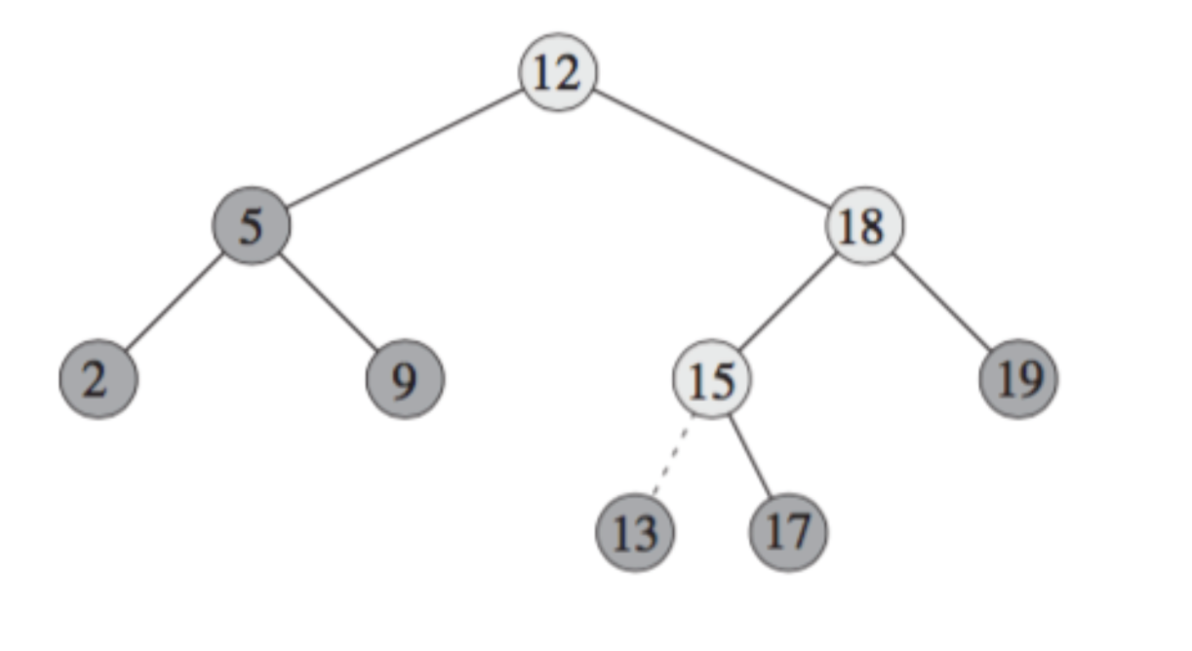
Binary Tree (BT)
  Each node contains one key
  Left sub-tree are less then the key in its parent node, in short L < P;
  Right sub-tree are greater the key in its parent node, in short P < R;
  No duplicate keys
Notes:
https://www.cs.cmu.edu/~adamchik/15-121/lectures/Trees/trees.html

Slide 10
Exercise (Binary Tree)
Problem: Draw a binary search tree by inserting the following numbers from left to right.
11, 6, 8, 19, 4, 10, 5, 17, 43, 49, 31
Notes:
http://fiftyexamples.readthedocs.io/en/latest/algorithms.html

Slide 11
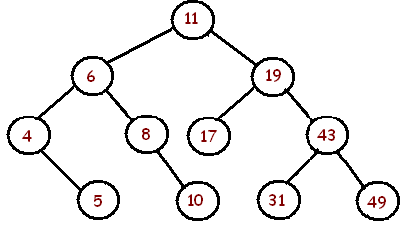

Slide 12
Applications:
  arithmetic expressions
decision processes
searching

Slide 13
Expression Trees
Expression Trees are yet another way to store mathematical expressions
Binary tree associated with an arithmetic expression
 internal nodes: operators
external nodes: operands
Example: arithmetic expression tree for the following expressions
(2 × (a −1) + (3 × b))
((x + y) * z)/300

Slide 14
Decision Trees
It is often useful to design decision trees
Binary tree associated with a decision process
  internal nodes: questions with yes/no answer
external nodes: decisions
Example: dining decision
Hungry?
OK
Hv Mny?
FR
Tea

Slide 15
Tree Traversal
Pre order- VLR
Post order- LRV
In order- LVR

Slide 17
Types of Binary Tress
Full Binary Tree A Binary Tree is a full binary tree if every node has 0 or 2 children.
Perfect Binary Tree A Binary tree is a Perfect Binary Tree in which all the internal nodes have two children, and all leaf nodes are at the same level.

Slide 18
#include <stdio.h>
#include <stdlib.h>
struct node {
int data;
struct node* left;
struct node* right;
};
struct node* newNode(int data)
{
struct node* node
= (struct node*)malloc(sizeof(struct node));
node->data = data;
node->left = NULL;
node->right = NULL;
return (node);
}
tree
----
1 <-- root
/ \
2 3
/
4
int main()
{
struct node* root = newNode(1);
root->left = newNode(2);
root->right = newNode(3);
root->left->left = newNode(4);
getchar();
return 0;
}

Slide 19
TUTORIAL
For any tree, T, define the following
  path in T
  height of a node in T
  depth of a node in T
  height of T
  depth of T
  external node
  internal node
  leaf

Slide 20
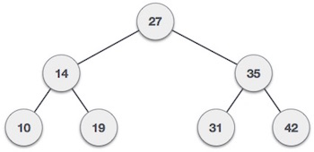
Find output of:
Preorder
Postorder
Inorder Traversal

Slide 21
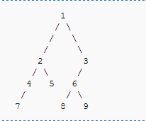
Find output of:
Preorder
Postorder
Inorder Traversal

Slide 22
Thank You

